Slide 1
Instructor Materials Chapter 2: Configure a Network Operating System
CCNA Routing and Switching
Introduction to Networks v6.0
Notes:
Cisco Networking Academy Program
Introduction to Networks v6.0
Chapter 2: Configure a Network Operating System

Slide 3
Chapter 2: Configure a Network Operating System
Introduction to Networks v6.0
Notes:
Cisco Networking Academy Program
Introduction to Networks v6.0
Chapter 2: Configure a Network Operating System

Slide 4
Chapter 2 - Sections & Objectives
2.1 IOS Bootcamp
Explain the purpose of Cisco IOS.
Explain how to access a Cisco IOS device for configuration purposes.
Explain how to navigate Cisco IOS to configure network devices.
Describe the command structure of Cisco IOS software.
2.2 Basic Device Configuration
Configure hostnames on a Cisco IOS device using the CLI.
Use Cisco IOS commands to limit access to device configurations.
Use IOS commands to save the running configuration.
2.3 Address Schemes
Explain how devices communicate across network media.
Configure a host device with an IP address.
Verify connectivity between two end devices.
Notes:
4

Slide 5
2.1 IOS Bootcamp
Notes:
Cisco Networking Academy Program
Introduction to Networks v6.0
Chapter 2: Configure a Network Operating System

Slide 6
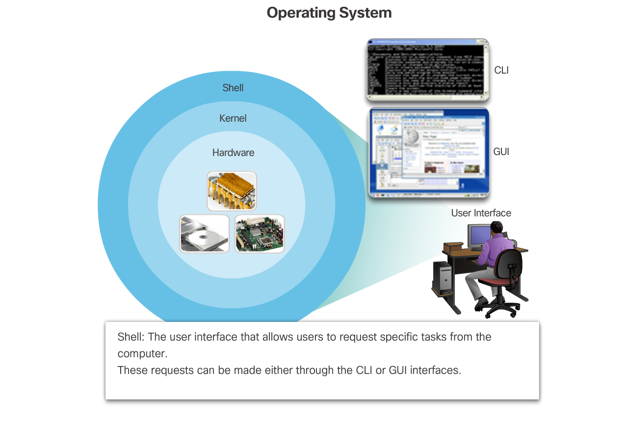
IOS Bootcamp Cisco IOS
Operating Systems
Every computer requires an operating system to function, including computer-based network devices such as switches, routers, access points, and firewalls. These network devices use an operating system called a network operating system.
An operating system has two basic parts. Shell and Kernel
A shell providers user interface.
A kernel interacts with hardware.
Notes:
2.1 – IOS Bootcamp
2.1.1 – Cisco IOS

Slide 7
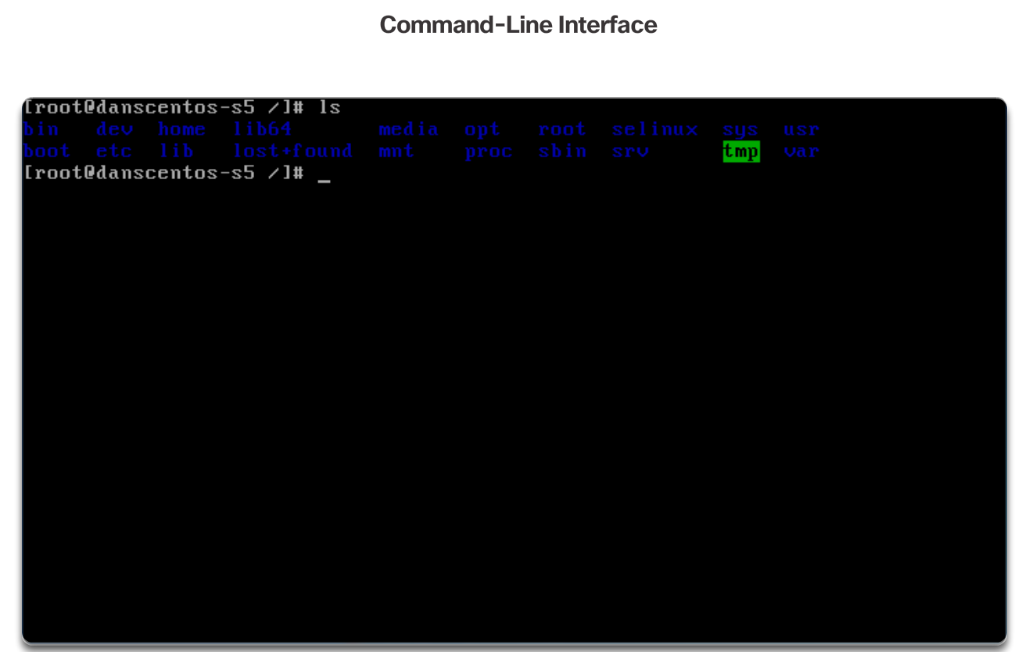
IOS Bootcamp Cisco IOS
Operating Systems
Operating System interface could either be Command-Line-Interface (CLI) or Graphical-User-Interface (GUI)
Notes:
2.1 – IOS Bootcamp
2.1.1 – Cisco IOS

Slide 8
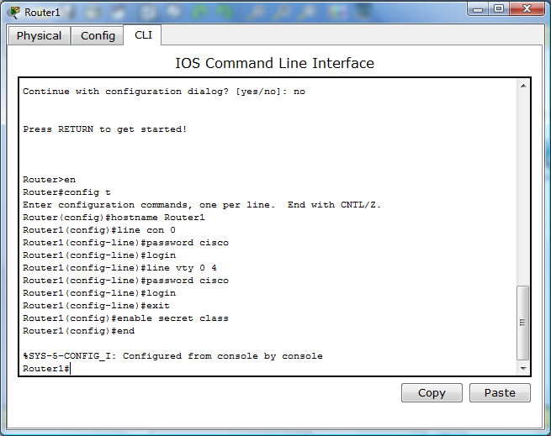
IOS Bootcamp Cisco IOS
Operating Systems
A Network Operating System (NOS) enables device hardware to function and provides an interface for users to interact.
Cisco devices like switch, routers etc has its own operating system known as Cisco Internetwork Operating System (Cisco IOS).
Cisco IOS allows users to interact with Cisco devices. It also allow users to configure or troubleshoot Cisco network devices.
Cisco IOS enables a technician to:
Use a keyboard to run CLI-based network programs.
Use a keyboard to enter text and text-based commands.
View output on a monitor.
Notes:
2.1 – IOS Bootcamp
2.1.1 – Cisco IOS

Slide 9
IOS Bootcamp Cisco IOS Access
Three Access Methods to access CLI (Command Line Interface) and configure Cisco devices (e.g. switch, router)
Console - This is a physical management port that provides out-of-band access to a Cisco device.
Auxiliary – is a legacy (i.e. old) auxiliary port that was used to establish a CLI session remotely using a modem. Similar to a console connection, the AUX port is out-of-band and does not require networking service
Virtual Terminal (Telnet / SSH)
SSH is a method for remotely establishing a secure CLI connection through a virtual interface, over a network. Unlike a console connection, SSH connections require active networking services on the device including an active interface configured with an address.
Telnet is an insecure method of remotely establishing a CLI session through a virtual interface, over a network. Unlike SSH, Telnet does not provide a securely encrypted connection. User authentication, passwords, and commands are sent over the network in plaintext.
Notes:
2.1 – IOS Bootcamp
2.1.3 – Cisco IOS Access

Slide 10
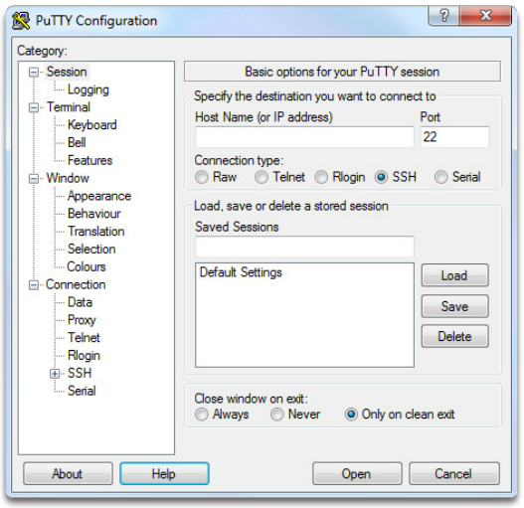
IOS Bootcamp Cisco IOS Access
Terminal Emulation Programs - allows you to connect to a networking device either by a serial connection over a console port or by a SSH/Telnet connection. Some of these include:
PuTTY
Tera Term
SecureCRT
Notes:
2.1 – IOS Bootcamp
2.1.3 – Cisco IOS Access

Slide 11
IOS Bootcamp Navigate the IOS
Cisco IOS Modes of Operation
Initial configuration must be done via console connection
Configuration is then done via various CLI command modes.
Primary Command Modes
User EXEC Mode - This mode has limited capabilities but is useful for basic operations. It allows only a limited number of basic monitoring commands but does not allow the execution of any commands that might change the configuration of the device. The user exec mode is identified with the prompt >.
Switch>
Router>
Privileged EXEC Mode - To execute configuration commands, a network administrator must access privileged EXEC mode. Higher configuration modes, like global configuration mode, can only be reached from privileged EXEC mode. The privileged EXEC mode can be identified by the prompt ending with the # symbol.
Switch#
Router#
Notes:
2.1 – IOS Bootcamp
2.1.3 – Navigate the IOS

Slide 12
IOS Bootcamp Navigate the IOS
Configuration Command Modes
The Configure Terminal command enters the Global Configuration Mode.
switch# configure terminal
switch(config)# [This is in global configuration mode]
Sub-configuration modes are accessible from the Privileged EXEC Mode.
switch# line console 0
switch(config-line)# [This is in line console sub-configuration]
switch# interface vlan 1
switch(config-if)# [This is in interface sub-configuration]
Navigate Between IOS Modes
Navigation between modes is also done via commands.
The enable command enters the Privileged EXEC Mode from User EXEC Mode.
The exit commands exits from sub-configuration to the parent command mode.
The end command or Ctrl+Z exits from sub-configuration to User EXEC Mode.
Notes:
2.1 – IOS Bootcamp
2.1.3 – Navigate the IOS

Slide 13
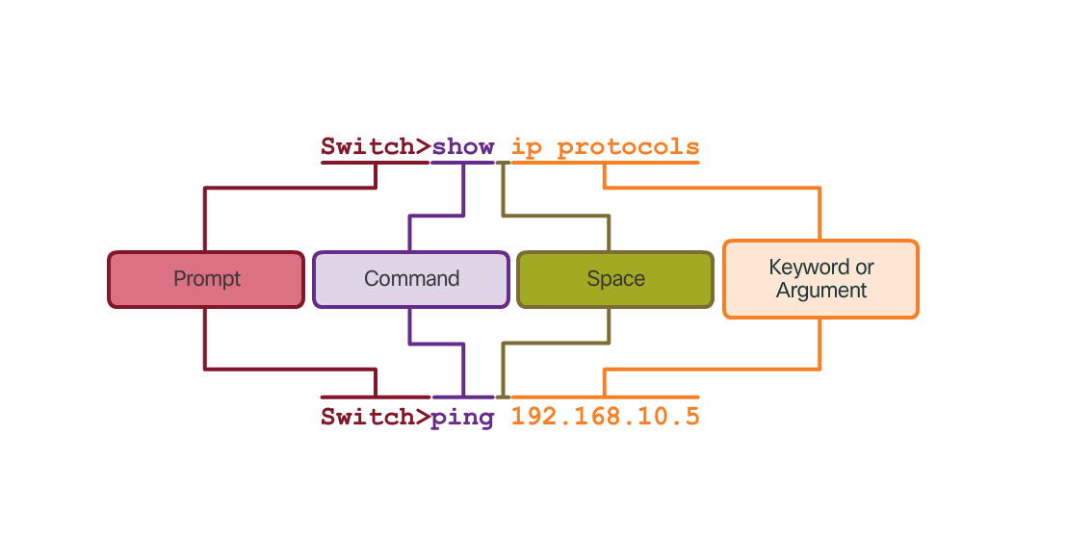
IOS Bootcamp The Command Structure
Basic IOS Command Structure
The general syntax for a command is the command followed by any appropriate keywords and arguments.
Keyword - a specific parameter defined in the operating system
Argument - not predefined; a value or variable defined by the user
IOS Command Syntax
Provides the pattern or format that must be used when entering a command.
The Cisco IOS Command Reference is the ultimate source of information for a particular IOS command.
Notes:
2.1 – IOS Bootcamp
2.1.3 –The Command Structure

Slide 14
IOS Bootcamp The Command Structure
IOS Help Feature
The IOS has two forms of help available: Context-Sensitive Help and Command Syntax Check.
Help using ? (Question Mark)
Router# ? [Will display all the commands on that mode]
Router(config)# zo? [Will display all commands that starts with zo]
zone zone-pair
Partial command using Tab key
Router(config)# conf<Tab>
Router(config)# configure [Will complete the whole word after Tab]
Hotkeys and Shortcuts
Commands and keywords can be shortened to the minimum number of characters that identify a unique selection.
Router> en [Instead of enable command you could use en]
Router# conf t [Instead of configure terminal command you could use conf t]
Notes:
2.1 – IOS Bootcamp
2.1.3 –The Command Structure

Slide 15
IOS Bootcamp The Command Structure
Notes:
2.1 – IOS Bootcamp
2.1.3 –The Command Structure

Slide 16
2.2 Basic Device Configuration
Notes:
Cisco Networking Academy Program
Introduction to Networks v6.0
Chapter 2: Configure a Network Operating System

Slide 17
Basic Device Configuration Hostnames
Device Names
Hostnames allow devices to be identified by network administrators over a network or the Internet.
Very important and should also be displayed in the topology.
Configure Hostnames
IOS hostnames should:
Start with a letter
Contain no spaces
End with letter or digit
Use only letters, digits or dashes
Be less than 64 characters in length
Notes:
2.2 – Basic Device Configuration
2.2.1 –Hostnames

Slide 18
Basic Device Configuration Limit Access to Device Configurations
Secure Device Access
Secure privileged EXEC and user EXEC access with a password.
Privilege EXEC password setup:
enable secret <password>
Router(config)# enable secret class
User EXEC password setup:
Router(config)# line console 0
Router(config-line)# password cisco
Router(config-line)# login
Secure virtual terminal lines with a password.
Router(config)# line vty 0 15
Router(config-line)# password cisco
Router(config-line)# login
Configure Passwords
Use more than 8 characters (above is for example only).
Use a combination of uppercase, lowercase, numbers and special characters.
Avoid re-using passwords
Notes:
2.2 – Basic Device Configuration
2.2.2 –Limit Access to Device Configurations

Slide 19
Basic Device Configuration Limit Access to Device Configurations
Encrypt Passwords
Cisco IOS displays passwords in plain text by default.
Passwords should be encrypted.
Router(config)# service password-encryption
Banner Messages
Important part of the legal process in the event that someone is prosecuted for breaking into a device.
Wording that implies that a login is "welcome" or "invited" is not appropriate.
Often used for legal notification because it is displayed to all connected terminals.
Router(config)# banner motd #No unauthorized access allowed violators will be prosecuted to the full extent of the law#
Notes:
2.2 – Basic Device Configuration
2.2.2 –Limit Access to Device Configurations

Slide 20
Basic Device Configuration Configuration Files
Start-up Configuration File
startup-config - File stored in NVRAM that contains all of the commands that will be used upon startup or reboot
NVRAM does not lose its contents when the device is powered off.
Start-up Configuration File
running-config - The file stored in Random Access Memory (RAM) that reflects the current configuration. Modifying a running configuration affects the operation of a Cisco device immediately. RAM is volatile memory. It loses all of its content when the device is powered off or restarted.
Showing running configuration
Router# show running-config
Notes:
2.2 – Basic Device Configuration
2.2.3 –Save Configurations

Slide 21
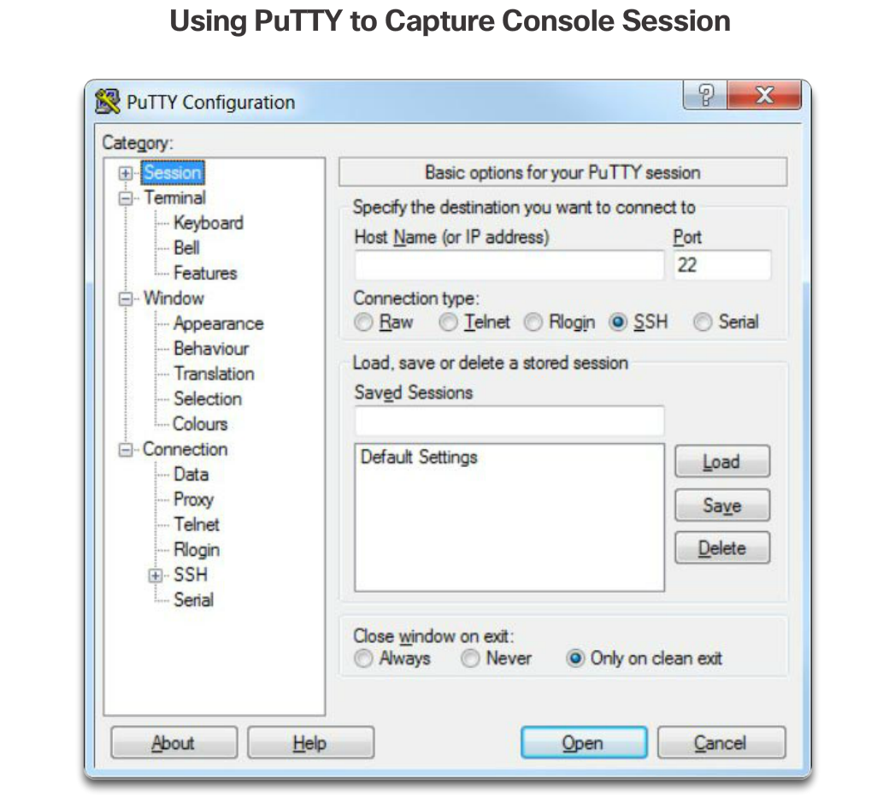
Basic Device Configuration Save Configurations
1
Save Configuration files
Router# copy running-config startup-config
Capture Configuration to a Text File
Configuration files can also be saved and archived to a text document.
The configuration can then be edited with any text editor and placed back in the device.
Open a terminal emulation software such as PuTTY or Tera Term connected to a switch.
Notes:
2.2 – Basic Device Configuration
2.2.3 –Save Configurations

Slide 22
Basic Device Configuration Save Configurations
2
Enable logging in the terminal software, such as PuTTY or Tera Term, and assign a name and file location to save the log file. As shown on the right figure, that All session output will be captured to the file specified (i.e., MySwitchLogs). Execute the show running-config or show startup-config command at the privileged EXEC prompt. Text displayed in the terminal window will be placed into the chosen file.
Notes:
2.2 – Basic Device Configuration
2.2.3 –Save Configurations

Slide 23
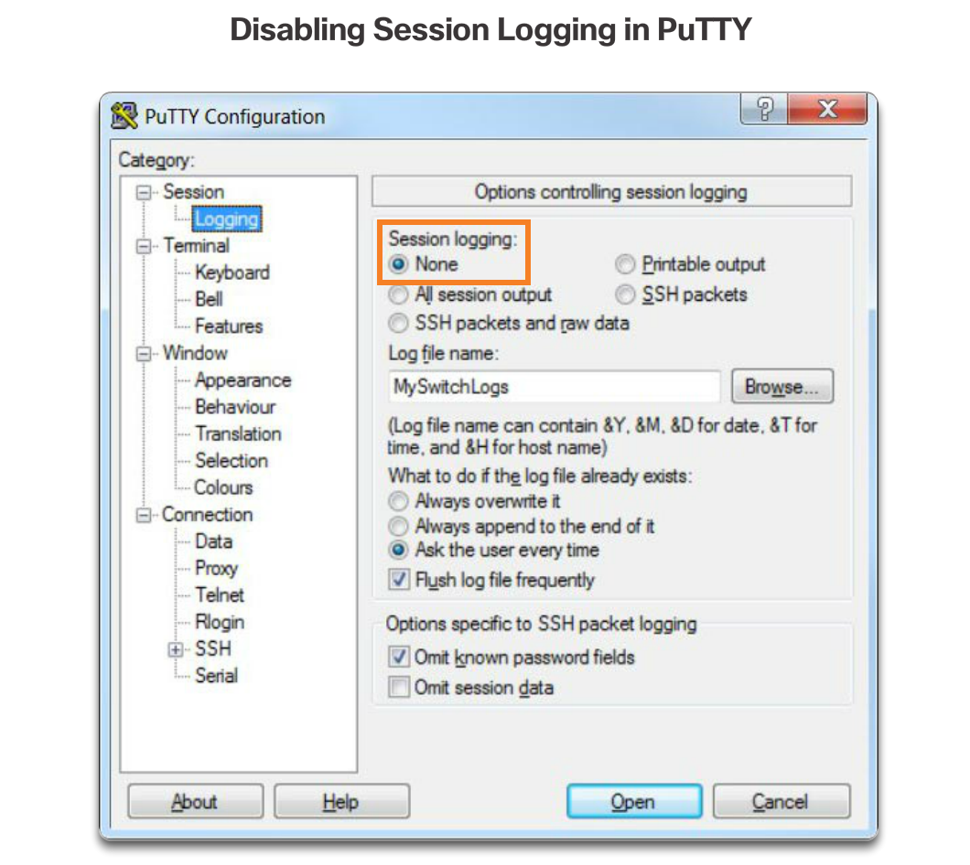
Basic Device Configuration Save Configurations
3
Disable logging in the terminal software. Figure 3 shows how to disable logging by choosing the None session logging option.
To restore a configuration file to a device:
Enter global configuration mode on the device.
Copy and paste the text file into the terminal window connected to the switch.
Notes:
2.2 – Basic Device Configuration
2.2.3 –Save Configurations

Slide 24
2.3 Address Schemes
Notes:
Cisco Networking Academy Program
Introduction to Networks v6.0
Chapter 2: Configure a Network Operating System

Slide 25
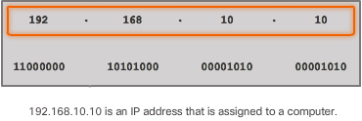
Address Schemes Ports and Addresses
IP Addresses
Each end device on a network must be configured with an IP address.
Enable devices to establish end-to-end communication on the Internet.
The structure of an IPv4 address is called dotted decimal notation and is represented by four decimal numbers between 0 and 255. Example : 192.168.10.10
IPv4 is 32 bits or 4 octets (8 bits).
IPv6 is the most recent version of IP and the replacement for the more common IPv4. IPv6 is 128 bits and uses hexadecimal values instead of decimal numbers.
Example: 2001:0DB8:0000:1133:0000:0000:0000:0200
Notes:
2.3 – Address Schemes
2.3.1 – Ports and Addresses

Slide 26
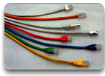
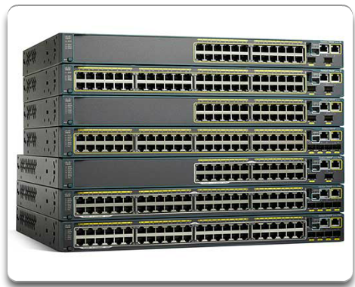
Address Schemes Ports and Addresses
Interface and Ports
Network communications depend on interfaces and the cables that connect them.
Different types of network media (e.g. twisted-pair copper cables, fiber-optic cables, coaxial cables, or wireless) have different features and benefits.
Ethernet is the most common local area network (LAN) technology.
Cisco IOS Layer 2 switches have physical ports for devices to connect. These ports do not support Layer 3 IP addresses. Therefore, switches have one or more switch virtual interfaces (SVIs). These are virtual interfaces because there is no physical hardware on the device associated with it. An SVI is created in software.
SVI provides a means to remotely manage a switch over a network.
Notes:
2.3 – Address Schemes
2.3.1 – Ports and Addresses

Slide 27
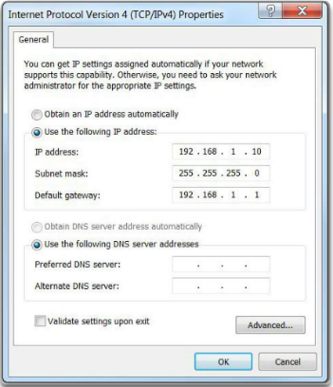
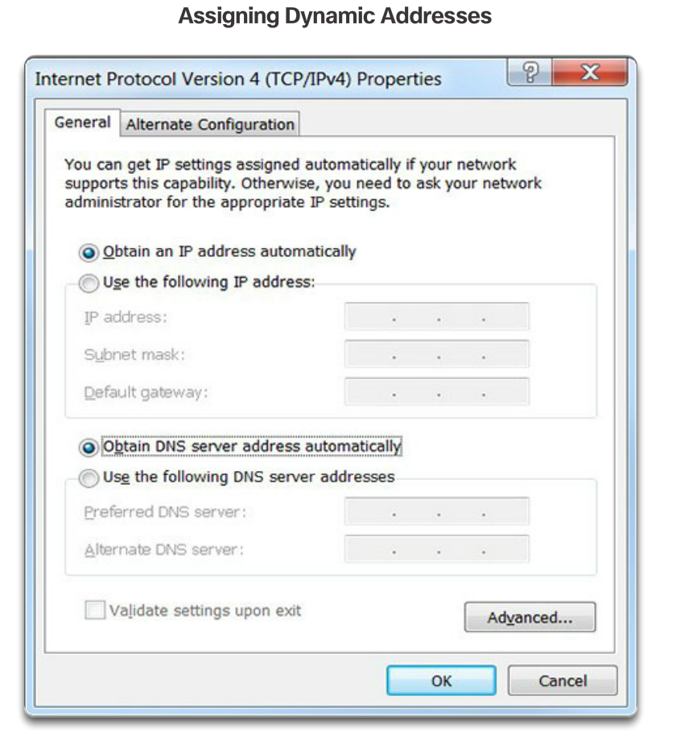
Address Schemes Configure IP Addressing
Manual IP Address Configuration for End Devices
To manually configure an IPv4 address on a Windows host, open the Control Panel > Network Sharing Center > Change adapter settings and choose the adapter.
Next right-click and select Properties to display the Local Area Connection Properties shown in Figure 1.
Automatic IP Address Configuration for End Devices
DHCP enables automatic IPv4 address configuration for every end device that has DHCP enabled. No extra configuration is needed.
Switch Virtual Interface Configuration
To configure an SVI on a switch, use the interface vlan 1 global configuration command. Vlan 1 is not an actual physical interface but a virtual one.
Notes:
2.3 – Address Schemes
2.3.2 – Configure IP Addressing

Slide 28
Address Schemes Configure IP Addressing
Switch Virtual Interface Configuration
To configure an SVI on a switch, use the interface vlan 1 global configuration command. Vlan 1 is not an actual physical interface but a virtual one.
Router(config)# interface vlan 1
[Assign IP address and subnet mask]
Router(config-lf)# ip address 192.168.1.10 255.255.255.0
[Activate interface]
Router(config-if)# no shutdown
Notes:
2.3 – Address Schemes
2.3.2 – Configure IP Addressing

Slide 29
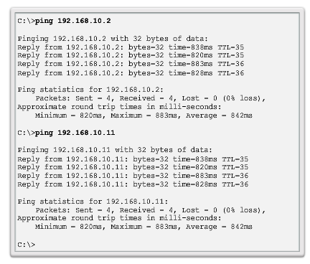
Address Schemes Verifying Connectivity
Interface Addressing Verification
Cisco IOS supports commands to allow IP configuration verification.
End-To-End Connectivity Test
The ping command can be used to test connectivity to another device on the network or a website on the Internet.
Notes:
2.3 – Address Schemes
2.3.3 – Verifying Connectivity

Slide 30
2.4 Chapter Summary
Notes:
Cisco Networking Academy Program
Introduction to Networks v6.0
Chapter 2: Configure a Network Operating System

Slide 31
Chapter Summary Summary
Explain the features and functions of Cisco IOS Software.
Configure initial settings on a network device using the Cisco IOS software.
Given an IP addressing scheme, configure IP address parameters on end devices to provide end-to-end connectivity in a small to medium-sized business network.
Notes:
2.4.1 - Summary

Slide 32
Section 2.1 New Terms and Commands
kernel
shell
Command-line interface (CLI)
Graphical user interface (GUI)
Cisco IOS
Firmware
Console
Out-of-band
SSH
Telnet
Auxiliary port (AUX)
PuTTY
Tera Term
SecureCRT
OS X Terminal
Cisco IOS modes
User EXEC mode
Privileged EXEC mode
Global Configuration Mode
Line configuration mode
Interface configuration mode
enable command
disable command
exit command
end command
Key combination – Ctrl+Z
Context-Sensitive Help
Command Syntax Check
CLI Hot Keys and Shortcuts
Hostnames
Notes:
New Terms and Commands

Slide 33
Section 2.2 New Terms and Commands
hostname name
Strong passwords
enable secret class
line console 0
password cisco
login
line vty 0 15
service password-encryption
banner motd # the message of the day #
Startup configuration
Random Access Memory (NVRAM)
Running configuration
Random Access Memory (RAM)
show running-config
copy running-config startup-config
reload
Notes:
New Terms and Commands

Slide 34
Section 2.3 New Terms and Commands
IPv4 address
Subnet mask
Default gateway
Physical ports
Virtual interface
Copper
Fiber Optics
Wireless
Ethernet
Local Area Network (LAN)
Layer 2 switch
Layer 3 addresses
Switch virtual interface (SVI)
Dynamic Host Configuration (DHCP)
Domain Name System (DNS)
ipconfig command prompt
interface vlan 1
Notes:
New Terms and Commands

